Slide 1
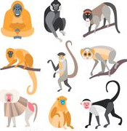
Primate Evolution
Intro
What are Primates?
Classifying Primates
Characteristics of Primates

Slide 2
What are Primates?
The Order of animals that includes Humans
Also includes:
Great Apes
Gibbons
Monkeys
Lemurs
Lorises
Tarsiers
Non-human primates are our closest living relatives, so can compare to see how human characteristics may have evolved.
Comparative anatomy
Comparative biochemistry
Behaviour of living primates
Fossils of primates

Slide 3
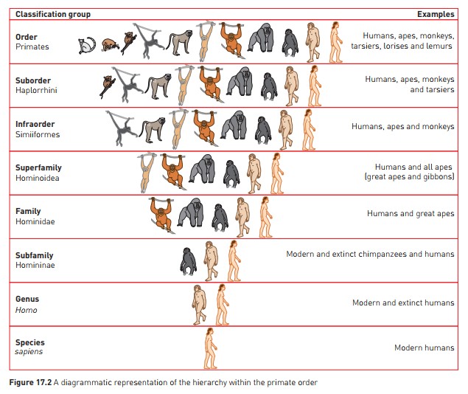

Slide 4
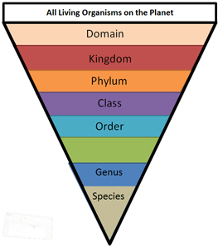
Classification and hierarchy

Slide 5
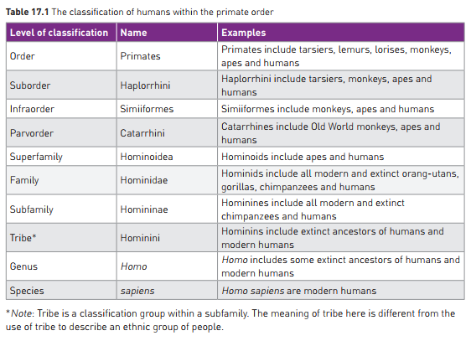

Slide 6
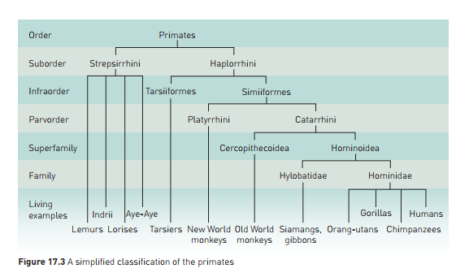

Slide 7
Classifying primates
Classification is a dynamic process: as new information comes to light, classification of an organism may change.
Eg:
Earlier classification divided primates into two groups:
Simians (humans and human-like primates)
Prosimians (primitive primates)
Tarsiers were included with prosimians, based on physical characteristics
Based on studies of protein sequences and DNA:
Most scientists now classify Tarsiers as more closely related to monkeys, apes and humans
Humans: classified in same family as great apes – we have very similar DNA and many shared characteristics.

Slide 8
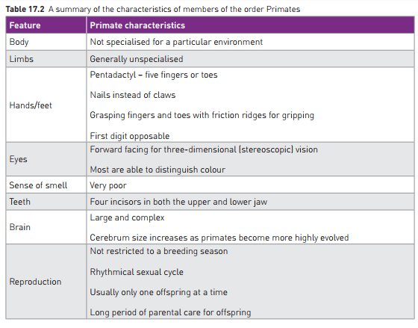
Primate Characteristics
Main features: combination of grasping fingers and toes, and overlapping binocular vision - distinctive to primates.

